Slide 1
Managing VMware infrastructure using salt-cloud
Nitin Madhok, Systems Developer, Clemson University
GitHub: @nmadhok
Twitter: @_nmadhok_
LinkedIn: https://linkedin.com/in/nitinmadhok
#oSC16 #openSUSE #Clemson #ClemsonTigers
Notes:
6/22/16
1
1

Slide 2
whoami
couple of things about me …
Spoken at various conferences including SaltConf15, OpenStack Summit 2015 (Tokyo), SaltConf16, openSUSE conference 2016 (Germany) etc.
Involved with the saltstack project since it’s early stages and also actively contribute to other open source projects such as OpenStack, GitLab etc.
Few of the significant contributions made include making Salt compatible with Python 3, creating salt-cloud VMware driver, creating DNS/ASAM/Spacewalk runners, creating ZFS/Zpool modules, maintaining saltstack-formulas etc.
Notes:
6/22/16
2
2

Slide 3
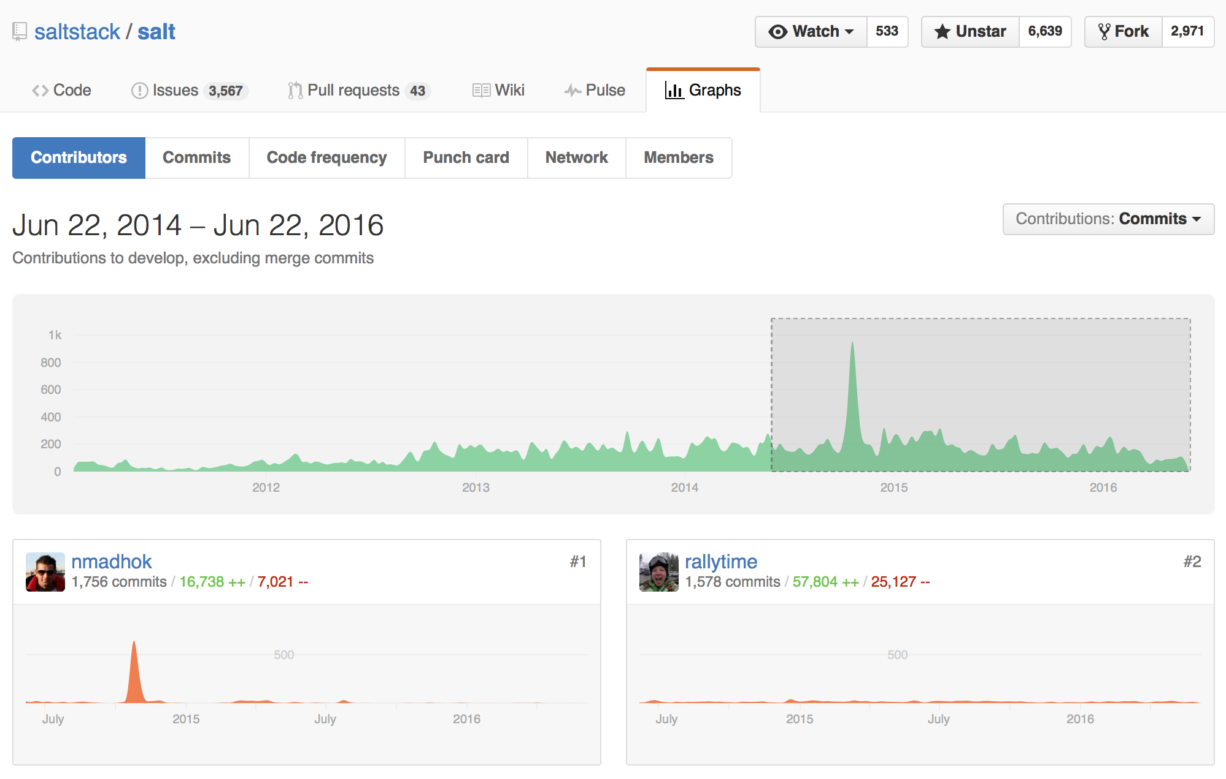
whoami
couple of things about me …
#1 rank by commits for contributions made to SaltStack projects within the past two years!
Notes:
6/22/16
3
3

Slide 4
agenda
what we will cover …
What is salt-cloud?
Basic terminology
Providers
Profiles
Maps
Live demo using salt-cloud with VMware
Notes:
6/22/16
4
4

Slide 5
salt-cloud
what is it? why was it created?
It is a private/public cloud provision tool
Integrates salt with cloud providers
Makes modeling and provisioning of minions quick and easy
Initially created to automatically accept keys on the master
Current integration with AWS, Azure, DigitalOcean, Google Compute Engine, HP Cloud, OpenStack, Rackspace, SoftLayer, VMware and many more!
Notes:
6/22/16
5
5

Slide 6
basic terminology
providers? profiles? maps?
Provider contains cloud provider related information.
Default location is /etc/salt/cloud.providers
Profile contains VM related information.
Default location is /etc/salt/cloud.profiles
Map can be used to specify multiple VM’s using the same profile.
Default location is /etc/salt/cloud.map
Notes:
6/22/16
6
6

Slide 7
Live Demo
Learn how to set up, configure, manage your VMware environment and deploy VMs using salt-cloud
Presentation content at:
https://github.com/nmadhok/oSC16
#oSC16 #openSUSE #Clemson #ClemsonTigers
Notes:
6/22/16
7
7

Slide 8
Follow me on:
GitHub: @nmadhok
Twitter: @_nmadhok_
LinkedIn: https://linkedin.com/in/nitinmadhok
Notes:
6/22/16
8
8

Slide 9
License
This slide deck is licensed under the Creative Commons Attribution-ShareAlike 4.0 International license.
It can be shared and adapted for any purpose (even commercially) as long as Attribution is given and any
derivative work is distributed under the same license. Details can be found at https://creativecommons.org/licenses/by-sa/4.0/
Credits
Template Richard Brown
rbrown@opensuse.org
Design & Inspiration
openSUSE Design Team
http://opensuse.github.io/branding-guidelines/
Notes:
6/22/16
9
9

